Slide 1



Noida Institute of Engineering and Technology, Greater Noida
NoSQL DATABASE
Unit: 3
Advance database management system
Shruti Dadhich
AIML dept
B Tech 6th Sem

Slide 2
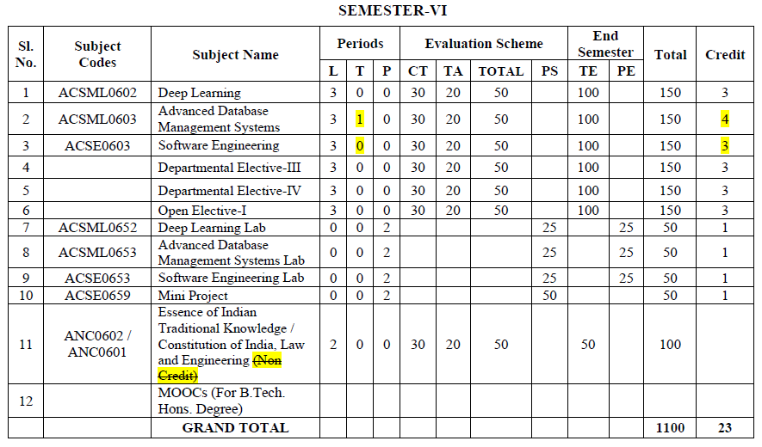
Evaluation Scheme

Slide 3
Syllabus
Introduction to relational database: Describe the relational model: Conformity and integrity, Use of constraints, Mapping design approaches to relational systems, Processing database data: Describe advanced SQL programming,
Query optimization: Query transformations, Optimization approaches, Use of constraints, Creation and use of a variety of index types.
Concurrency control and transaction management: The ACID principle, Two-phase locking and Deadlocks, Recovery and transaction design.

Slide 4
Branch wise Application
There are various application of Advance DBMS in different fields like:
Railway Reservation System,
Library Management System,
Banking,
Universities and colleges,
Credit card transactions etc.

Slide 5
Course Objective
This course provides an introduction to the advanced database management system.
The course introduces both theoretical (knowledge-based) and practical approaches, illustrate the use of advanced database and tools in a variety of application areas, as well as provide insight into many open research problems.

Slide 6
Content
Introduction to relational database
Describe the relational model Conformity and integrity
Use of constraints
Mapping design approaches to relational systems
Processing database data
Describe advanced SQL programming
Query optimization
Query transformations
Optimization approaches
Use of constraints
Creation and use of a variety of index types
Concurrency control and transaction management
The ACID principle
Two-phase locking and Deadlocks
Recovery and transaction design

Slide 7
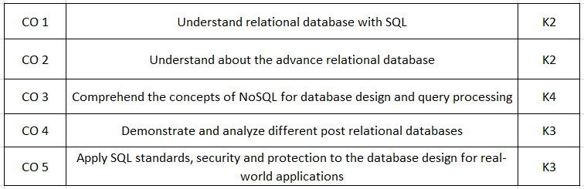
Course Outcomes(COs)

Slide 8
Program Outcomes (POs)
Engineering Graduates will be able to:
1. Engineering knowledge: Apply the knowledge of mathematics, science, engineering fundamentals, and an engineering specialization to the solution of complex engineering problems.
2. Problem analysis: Identify, formulate, review research literature, and analyze complex engineering problems reaching substantiated conclusions using first principles of mathematics, natural sciences, and engineering sciences.
3. Design/development of solutions: Design solutions for complex engineering problems and design system components or processes that meet the specified needs with appropriate consideration for the public health and safety, and the cultural, societal, and environmental considerations.
4. Conduct investigations of complex problems: Use research-based knowledge and research methods including design of experiments, analysis and interpretation of data, and synthesis of the information to provide valid conclusions.

Slide 9
Program Outcomes (POs)
5. Modern tool usage: Create, select, and apply appropriate techniques, resources, and modern engineering and IT tools including prediction and modeling to complex engineering activities with an understanding of the limitations.
6. The engineer and society: Apply reasoning informed by the contextual knowledge to assess societal, health, safety, legal and cultural issues and the consequent responsibilities relevant to the professional engineering practice.
7. Environment and sustainability: Understand the impact of the professional engineering solutions in societal and environmental contexts, and demonstrate the knowledge of, and need for sustainable development.
8. Ethics: Apply ethical principles and commit to professional ethics and responsibilities and norms of the engineering practice.

Slide 10
Program Outcomes (POs)
9. Individual and team work: Function effectively as an individual, and as a member or leader in diverse teams, and in multidisciplinary settings.
10. Communication: Communicate effectively on complex engineering activities with the engineering community and with society at large, such as, being able to comprehend and write effective reports and design documentation, make effective presentations, and give and receive clear instructions.
11. Project management and finance: Demonstrate knowledge and understanding of the engineering and management principles and apply these to one’s own work, as a member and leader in a team, to manage projects and in multidisciplinary environments.
12. Life-long learning: Recognize the need for, and have the preparation and ability to engage in independent and life-long learning in the broadest context of technological change.

Slide 11
Program Educational Objectives (PEOs)
PEO1:
Able to apply sound knowledge in the field of information technology to fulfill the needs of IT industry.
PEO2:
Able to design innovative and interdisciplinary systems through latest digital technologies.
PEO3:
Able to inculcate professional ethics, team work and leadership for serving the society.
PEO4:
Able to inculcate lifelong learning in the field of computing for successful career in organizations and R&D sectors.

Slide 12
COs and POs Mapping
 | PO1 | PO2 | PO3 | PO4 | PO5 | PO6 | PO7 | PO8 | PO9 | PO10 | PO11 | PO12
 | 2 | 2 | 3 | 3 | 3 | 2 | 3 | 2 | 2 | 2 | 2 | 3
KCS501.2 | 3 | 3 | 3 | 2 | 2 | 2 | 2 | 2 | 2 | 2 | 2 | 3
KCS501.3 | 2 | 3 | 3 | 3 | 3 | 2 | 2 | 2 | 2 | 2 | 2 | 2
KCS501.4 | 2 | 3 | 2 | 2 | 2 | 2 | 2 | 2 | 2 | 3 | 2 | 2
KCS501.5 | 2 | 3 | 2 | 2 | 2 | 3 | 2 | 2 | 3 | 2 | 2 | 2
AVG | 2.20 | 2.80 | 2.60 | 2.40 | 2.40 | 2.20 | 2.20 | 2.00 | 2.20 | 2.20 | 2.00 | 2.40

Slide 13
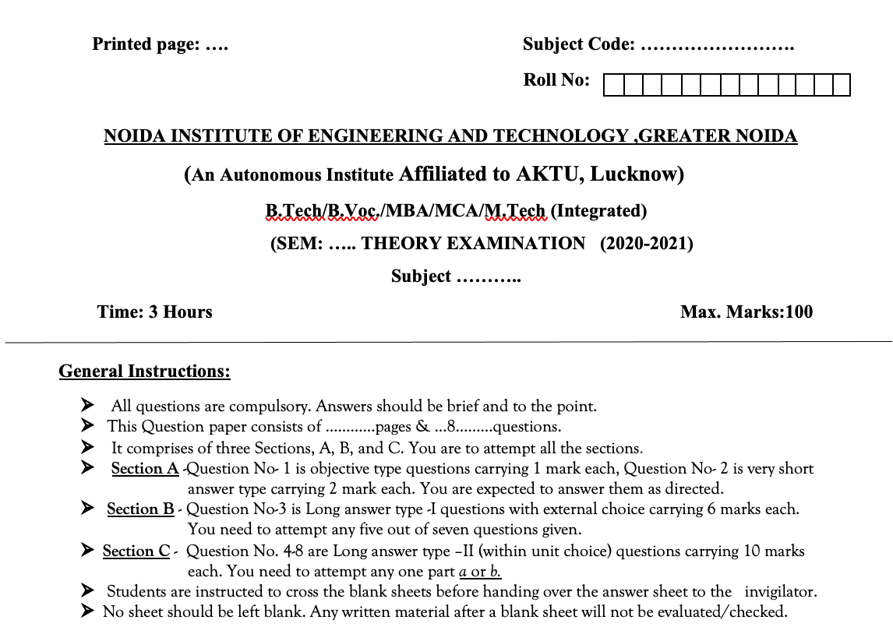
Question Paper Template

Slide 14
Question Paper Template
 |  | SECTION – A |  | CO
 | Attempt all parts- |  | [10×1=10]
 | 1-a. | Question- | (1)
 | 1-b. | Question- | (1)
 | 1-c. | Question- | (1)
 | 1-d. | Question- | (1)
 | 1-e. | Question- | (1)
 | 1-f. | Question- | (1)
 | 1-g. | Question- | (1)
 | 1-h. | Question- | (1)
 | 1-i. | Question- | (1)
 | 1-j. | Question- | (1)
2. | Attempt all parts- |  | [5×2=10] | CO
 | 2-a. | Question- | (2)
 | 2-b. | Question- | (2)
 | 2-c. | Question- | (2)
 | 2-d. | Question- | (2)
 | 2-e. | Question- | (2)
SECTION – B |  |  |  | CO
3. | Answer any five of the following- |  | [5×6=30]
 | 3-a. | Question- | (6)
 | 3-b. | Question- | (6)
 | 3-c. | Question- | (6)
 | 3-d. | Question- | (6)
 | 3-e. | Question- | (6)
 | 3-f. | Question- | (6)
 | 3-g. | Question- | (6)
SECTION – C |  |  |  | CO
4 | Answer any one of the following- |  | [5×10=50]
 | 4-a. | Question- | (10)
 | 4-b. | Question- | (10)
5. | Answer any one of the following-
 | 5-a. | Question- | (10)
 | 5-b. | Question- | (10)
6. | Answer any one of the following-
 | 6-a. | Question- | (10)
 | 6-b. | Question- | (10)
7. | Answer any one of the following-
 | 7-a. | Question- | (10)
 | 7-b. | Question- | (10)
8. | Answer any one of the following-
 | 8-a. | Question- | (10)
 | 8-b. | Question- | (10)

Slide 15
Prerequisite and Recap
The student should have knowledge of relational database management system (RDBMS) and SQL.
Having knowledge of basic mathematics like - SUM, DIFFERENCE, AVERAGE, MEAN, MEDIAN, MODE, etc will definitely be a plus point.
Having knowledge on Set Theory will help.
The proper understanding of data structures (B and B+ trees) will help you to understand the DBMS quickly.

Slide 16
Unit Objective
Students will be able to learn various Non-Relational Data Model Concepts, constraints.
Overview on NoSQL and Various queries and operations in NoSQL which helps to communicate with the database. Along with MongoDB introduction and CRUD operations, features and different query processing.

Slide 17
Introduction to NoSQL
A NoSQL database includes simplicity of design, simpler horizontal scaling to clusters of machines and finer control over availability. The data structures used by NoSQL databases are different from those used by default in relational databases which makes some operations faster in NoSQL.
Such databases came into existence in the late 1960s but did not obtain the NoSQL moniker until a surge of popularity in the early twenty-first century. NoSQL databases are used in real-time web applications and big data and their use are increasing over time. NoSQL systems are also sometimes called Not only SQL to emphasize the fact that they may support SQL-like query languages.
NoSQL originally referring to non-SQL or non relational. It is a database that provides a mechanism for storage and retrieval of data. This data is modeled in means other than the tabular relations used in relational databases.

Slide 18
What is NoSQL and what is a NoSQL database?
NoSQL database technology stores information in JSON(Java Script Object Notation) documents instead of columns and rows used by relational databases. To be clear, NoSQL stands for “not only SQL” rather than “no SQL” at all.
This means a NoSQL JSON database can store and retrieve data using literally “no SQL.” Or you can combine the flexibility of JSON with the power of SQL for the best of both worlds. Consequently, NoSQL databases are built to be flexible, scalable, and capable of rapidly responding to the data management demands of modern businesses.
The following defines the four most-popular types of NoSQL database:
Graph Databases: Amazon Neptune, Neo4j
Key value store: Memcached, Redis, Coherence
Tabular: Hbase, Big Table, Accumulo
Document-based: MongoDB, CouchDB, Cloudant

Slide 19
Features Of NoSQL
It never follows relational database model.
It never provides table with flat fixed column record.
It is schema free.
It provides share nothing environment.
It is scalable.
It has low-cost hardware.
It provides faster performance. Example : MongoDB , Cassandra.

Slide 20
Advantages Of NoSQL
1. High Scalability –
NoSQL databases use sharding for horizontal scaling. Partitioning of data and placing it on multiple machines in such a way that the order of the data is preserved is sharding.
Vertical scaling is not that easy to implement but horizontal scaling is easy to implement.
Examples of horizontal scaling databases are MongoDB, Cassandra, etc.
2. High Availability –
Vertical scaling means adding more resources to the existing machine
Auto replication feature in NoSQL databases makes it highly available because in case of any failure data replicates itself to the previous consistent state.
Horizontal scaling means adding more machines to handle the data.
NoSQL can handle a huge amount of data because of scalability, as the data grows NoSQL scale itself to handle that data in an efficient manner.

Slide 21
Disadvantages of NoSQL
Narrow focus –
NoSQL databases have a very narrow focus as it is mainly designed for storage, but it provides very little functionality. Relational databases are a better choice in the field of Transaction Management than NoSQL.
Open-source –
NoSQL is open-source database. There is no reliable standard for NoSQL yet. In other words, two database systems are likely to be unequal.
Management challenge –
The purpose of big data tools is to make the management of a large amount of data as simple as possible. But it is not so easy. Data management in NoSQL is much more complex than in a relational database.
NoSQL has a reputation for being challenging to install and even more hectic to manage on a daily basis.

Slide 22
Distributed Databases: Sharding and Replication
In context to the scaling of the MongoDB database, it has some features know as Replication and Sharding.
Replication can be simply understood as the duplication of the data-set.
Sharding is partitioning the data-set into discrete parts.
By sharding, we divided our collection into different parts. Replicating our database means we make imagers of our data-set. In terms of functionality delivered.

Slide 23
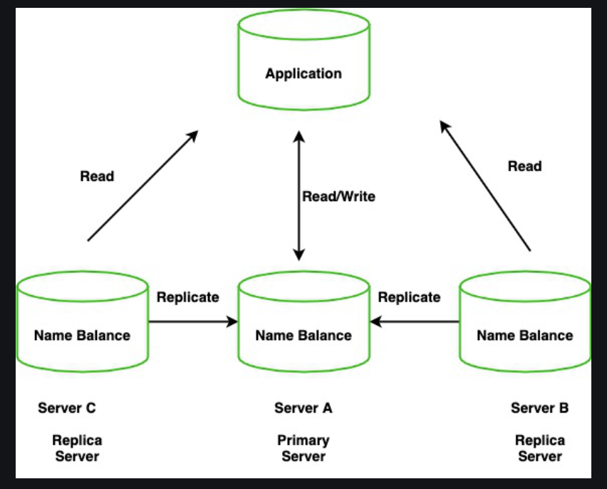
Replication
Replication is the method of duplication of data across multiple servers.
For example, we have an application, and it reads and writes data to a database and says this server A has a name and balance which will be copied/replicate to two other servers in two different locations.

Slide 24
Replication
By doing this, will get redundancy and increases data availability with multiple copies of data on different database servers. So, it will increase the performance of reading scaling. The set of servers that maintain the same copy of data is known as replica servers or MongoDB instances

Slide 25
Key Features of Replication
All the secondary nodes relate to the primary nodes. there is one heartbeat signal from the primary nodes. If the primary server goes down an eligible secondary will hold the new primary.
The primary server receives all write operations and record all the changes to the data i.e, oplog.
The secondary members then copy and apply these changes in an asynchronous process.
Replica sets are the clusters of N different nodes that maintain the same copy of the data set.

Slide 26
Why Replication?
High Availability of data disasters recovery
No downtime for maintenance ( like backups index rebuilds and compaction)
Read Scaling (Extra copies to read from)

Slide 27
Sharding
Sharding is a method for allocating data across multiple machines.
MongoDB used sharding to help deployment with very big data sets and large throughput the operation. By sharding, you combine more devices to carry data extension and the needs of read and write operations.

Slide 28
Why Sharding?
Database systems having big data sets or high throughput requests can doubt the ability of a single server.
For example, High query flows can drain the CPU limit of the server.
The working set sizes are larger than the system’s RAM to stress the I/O capacity of the disk drive.

Slide 29
How does Sharding work?
Sharding determines the problem with horizontal scaling breaking the system dataset and store over multiple servers, adding new servers to increase the volume as needed.

Slide 30
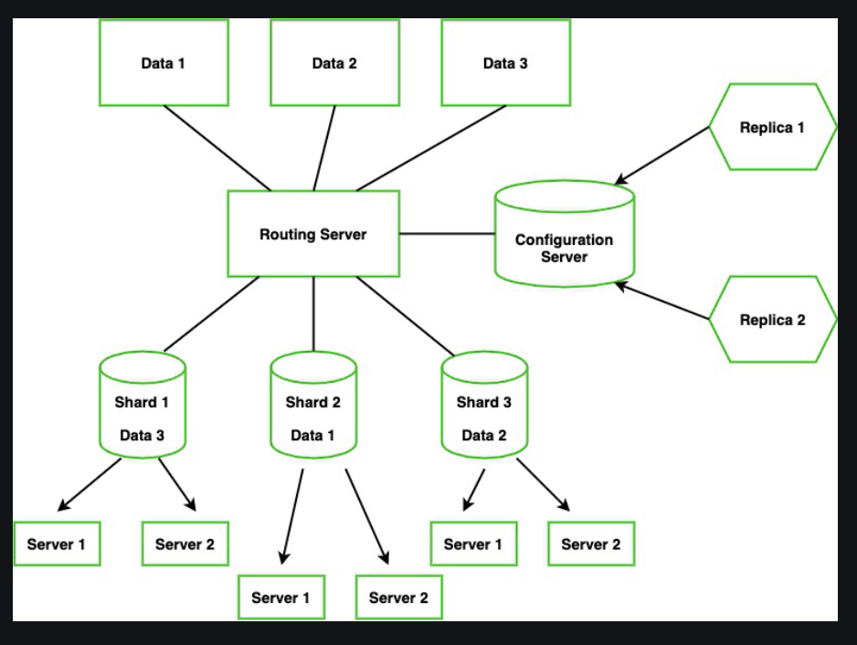
How does Sharding work?

Slide 31
How does Sharding work?
Now, instead of one signal as primary, we have multiple servers called Shard.
We have different routing servers that will route data to the shard servers.
For example: Let say we have Data 1, Data 2, and Data 3 this will be going to the routing server which will route the data (i.e, Different Data will go to a particular Shard )Each Shard holds some pieces of data.
Here the configuration server will hold the metadata and it will configure the routing server to integrate the data to a shard.
However, configure server is the MongoDB instance if it goes down then the entire server will go down, So it again has Replica Configure database.

Slide 32
Advantages of Sharding
Sharding adds more server to a data field automatically adjust data loads across various servers.
The number of operations each shard manage got reduced.
It also increases the write capacity by splitting the write load over multiple instances.
It gives high availability due to the deployment of replica servers for shard and config.
Total capacity will get increased by adding multiple shards.

Slide 33
Consistency in Database Systems
Database consistency ensures the data base entities are in healthy state i.e.; they follow all the application integrity constraints. Ex: any operation must make sure maximum data type length, unique key, primary key, foreign key constraints etc are absolutely maintained. It does not care about the operation operating on the given data, rather the relevance of the outcome of the operation is more important.

Slide 34
Consistency in Distributed Systems
Consistency in distributed systems means every node / replica has the same view of data at a given point in time irrespective of whichever client has updated the data. When you make a request to any node, you receive the exact same response (even if it’s an error) so that from the outside, it looks like there is a single node performing all the operations.

Slide 35
Eventual vs Strong Consistency in Distributed Databases
1. Eventual Consistency :
Eventual consistency is a consistency model that enables the data store to be highly available. It is also known as optimistic replication & is key to distributed systems. So, how exactly does it work? Let’s Understand this with the help of a use case.

Slide 36
Conti…
Real World Use Case :
Think of a popular microblogging site deployed across the world in different geographical regions like Asia, America, and Europe. Moreover, each geographical region has multiple data center zones: North, East, West, and South.
Furthermore, each zone has multiple clusters which have multiple server nodes running. So, we have many datastore nodes spread across the world that micro-blogging site uses for persisting data. Since there are so many nodes running, there is no single point of failure.

Slide 37
Conti…
Real World Use Case :
The data store service is highly available. Even if a few nodes go down persistence service is still up. Let’s say a celebrity makes a post on the website that everybody starts liking around the world.
At a point in time, a user in Japan likes a post which increases the “Like” count of the post from say 100 to 101. At the same point in time, a user in America, in a different geographical zone, clicks on the post, and he sees “Like” count as 100, not 101.

Slide 38
2. Strong Consistency :
2. Strong Consistency :
Strong Consistency simply means the data must be always strongly consistent. All the server nodes across the world should contain the same value as an entity at any point in time. And the only way to implement this behavior is by locking down the nodes when being updated

Slide 39
Conti…
World Use Case :
Let’s continue the same Eventual Consistency example from the previous lesson. To ensure Strong Consistency in the system, when a user in Japan likes posts, all nodes across different geographical zones must be locked down to prevent any concurrent updates.
This means at one point in time, only one user can update the post “Like” counter value. So, once a user in Japan updates the “Like” counter from 100 to 101. The value gets replicated globally across all nodes. Once all nodes reach consensus, locks get lifted. Now, other users can Like posts.

Slide 40
Conti…
World Use Case :
If the nodes take a while to reach a consensus, they must wait until then. Well, this is surely not desired in the case of social applications. But think of a stock market application where the users are seeing different prices of the same stock at one point in time and updating it concurrently. This would create chaos. Therefore, to avoid this confusion we need our systems to be Strongly Consistent.
The nodes must be locked down for updates. Queuing all requests is one good way of making a system Strongly Consistent. The strong Consistency model hits the capability of the system to be Highly Available & perform concurrent updates. This is how strongly consistent ACID transactions are implemented.

Slide 41
CAP Theorem
The CAP theorem is a belief from theoretical computer science about distributed data stores that claims.
The CAP theorem, originally introduced as the CAP principle, can be used to explain some of the competing requirements in a distributed system with replication.
Also named Brewer's theorem after computer scientist Eric Brewer.
CAP Theorem
In the event of a network failure on a distributed database, it is possible to provide either consistency or availability—but not both.
It is a tool used to make system designers aware of the trade-offs while designing networked shared-data systems.

Slide 42
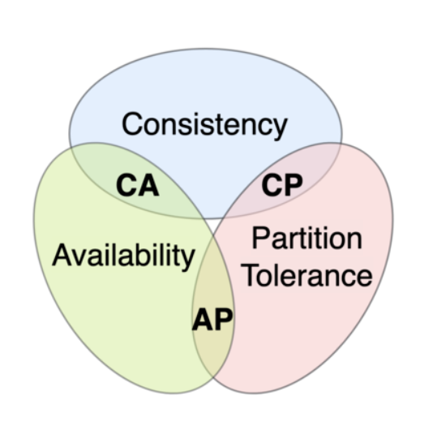
CAP Theorem
The CAP Theorem is comprised of three components (hence its name) as they relate to distributed data stores:
Consistency. All reads receive the most recent write or an error.
Availability. All reads contain data, but it might not be the most recent.
Partition tolerance. The system continues to operate despite network failures (i.e.; dropped partitions, slow network connections, or unavailable network connections between nodes.)

Slide 43
CAP Theorem
When a network partition failure happens, it must be decided whether to do one of the following:
cancel the operation and thus decrease the availability but ensure consistency
proceed with the operation and thus provide availability but risk inconsistency.
Thus, if there is a network partition, one has to choose between consistency or availability. Note that consistency as defined in the CAP theorem is quite different from the consistency guaranteed in ACID database transactions.

Slide 44
CAP Theorem
1. Consistency
Consistency means that the nodes will have the same copies of a replicated data item visible for various transactions.
A guarantee that every node in a distributed cluster returns the same, most recent and a successful write.
Consistency refers to every client having the same view of the data. There are various types of consistency models. Consistency in CAP refers to sequential consistency, a very strong form of consistency.

Slide 45
CAP Theorem
2. Availability
Availability means that each read or write request for a data item will either be processed successfully or will receive a message that the operation cannot be completed.
Every non-failing node returns a response for all the read and write requests in a reasonable amount of time.
The key word here is “every”. In simple terms, every node (on either side of a network partition) must be able to respond in a reasonable amount of time.

Slide 46
CAP Theorem
3. Partition Tolerance
Partition tolerance means that the system can continue operating even if the network connecting the nodes has a fault that results in two or more partitions, where the nodes in each partition can only communicate among each other.
That means, the system continues to function and upholds its consistency guarantees in spite of network partitions.
Network partitions are a fact of life. Distributed systems guaranteeing partition tolerance can gracefully recover from partitions once the partition heals.

Slide 47
Types of NoSQL Data Models
1. Key-Value Store
2. Document Based Store NoSQL
3. Column Based Store
4. Graph Based Store

Slide 48
Conti…
1. Key-Value Store
It simply uses the key value to store data in the database. The key in the key-value pair must be unique.
The rules set for what the key can be the length for the size of the key depends on the database to the database. For example, in Redis, the maximum size for Key is 512mb. Even the empty string is a valid key.
The size of the key is important here as a long key can cause performance issues whereas a too short a key can cause readability issues.

Slide 49
Conti…
1. Key-Value Store Conti…
The value in the key-value pair can be anything from a String to an image. You can also specify the data type of the value here. The key-value database model can be useful for storing data on Ecommerce like product categories, product details, etc. These are extensively used in big data analytics.
We can even store complete URLs as the URL name can be the key and the actual URL as value. Examples of databases applying Key-Value pairs are Oracle NoSQL database and Redis.

Slide 50
Conti…
2. Document Based Store NoSQL
In this type of database, the record and its associated data are stored in a single document. So this model is not completely unstructured, but it is a kind of Semi-structured data.
The difference between a document and Key value pair is that in document type storage is that in this type encoding is provided while storing the data in documents, it can be XML encoding or JSON encoding.

Slide 51
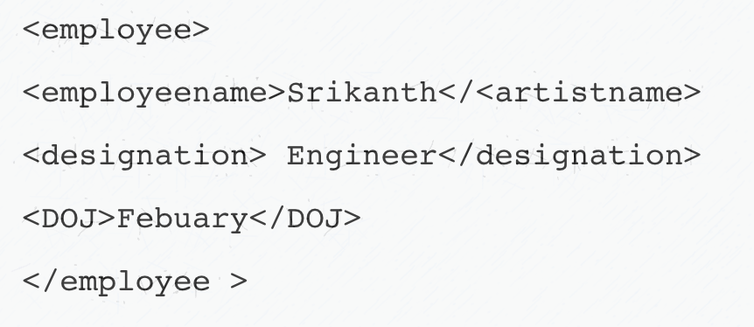
Conti…
2. Document Based Store NoSQL Conti…
The below example shows a document that can be stored in a document database but with a different encoding. Let’s look at the XML example.

Slide 52
Conti…
2. Document Based Store NoSQL Conti…
The difference between conventional databases and document-based databases is that data here is not stored in tables like conventional databases but are stored in documents.
The examples of databases using the above data model are MongoDB and Couchbase. These types of databases are used extensively especially in big data analysis.

Slide 53
Conti…
3. Column Based Store
The focus is on columns rather than rows as data is stored in columns instead of rows which is the case with most relational databases. Since data is stored in cells grouped in columns so all read-write is done using columns, not rows.
The interesting question arises is that why use columns rather than rows?
As an example, if we want to query titles from million articles, it will be easy to get in the column-based data model as with one disk entry we will get the titles of the article easily whereas in relational databases it has to get over to each location to get the titles. Examples of Column based store databases is HBase, Big Table, Cassandra.
The answer to this question is that when you store data in columns you can do a fast search and fast retrieval and aggregation because it stores all the cells of a column as a continuous entry which then allows faster access.

Slide 54
Conti…
3. Column Based Store
As the name suggests graphical representation is used instead of tables or columns representation. The important feature of this type of data model is the presence of nodes and edges. The two nodes, for example, are connected with some relationships and the relationship here is represented by edges.
Also, you can efficiently transform data from one model to another using this Graph-based NoSQL data model. There are two commonly used graph-based databases which are InfoGrid and Infinite Graph. InfoGrid also offers two kinds of graph databases like MeshBase and NetMeshbase which users can choose depends on the requirements of the user.

Slide 55
Conti…
4. Graph Based Store
As the name suggests graphical representation is used instead of tables or columns representation. The important feature of this type of data model is the presence of nodes and edges. The two nodes, for example, are connected with some relationships and the relationship here is represented by edges.
Also, you can efficiently transform data from one model to another using this Graph-based NoSQL data model. There are two commonly used graph-based databases which are InfoGrid and Infinite Graph. InfoGrid also offers two kinds of graph databases like MeshBase and NetMeshbase which users can choose depends on the requirements of the user.

Slide 56
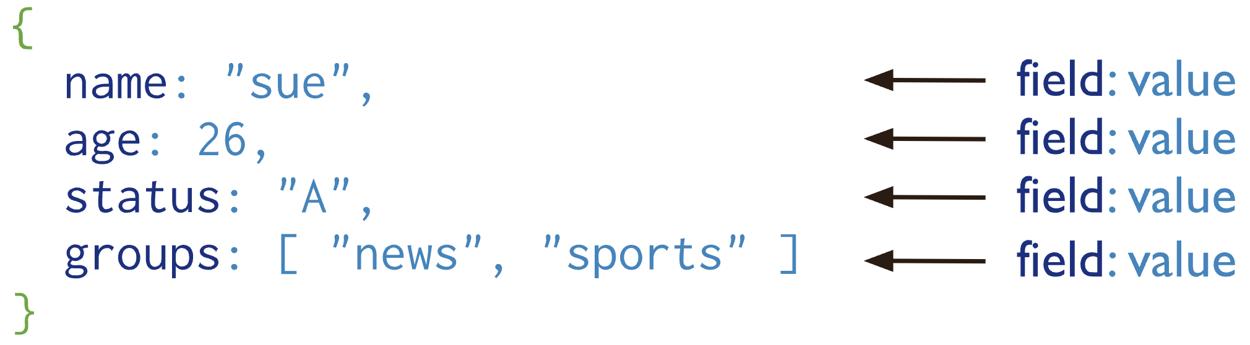
MongoDB: An introduction
A record in MongoDB is a document, which is a data structure composed of field and value pairs. MongoDB documents are like JSON objects. The values of fields may include other documents, arrays, and arrays of documents.
Document Database

Slide 57
Conti…
The advantage:
Documents correspond to native data types in many programming languages.
Embedded documents and arrays reduce need for expensive joins.
Dynamic schema supports fluent polymorphism.

Slide 58
Conti…
High Performance
Query API
High Availability
Horizontal Scalability
Support for Multiple Storage Engines
Key Features

Slide 59
Difference Between SQL And NoSQL
SQL | NoSQL
RELATIONAL DATABASE MANAGEMENT SYSTEM (RDBMS) | Non-relational or distributed database system.
These databases have fixed or static or predefined schema | They have dynamic schema
These databases are not suited for hierarchical data storage. | These databases are best suited for hierarchical data storage.
These databases are best suited for complex queries | These databases are not so good for complex queries
Vertically Scalable | Horizontally scalable
Follows ACID property | Follows CAP(consistency, availability, partition tolerance)
Examples: MySQL, PostgreSQL, Oracle, MS-SQL Server, etc | Examples: MongoDB, GraphQL, HBase, Neo4j, Cassandra, etc

Slide 60
CRUD Operations With MongoDB
CRUD Operations Create, Read, Update, And Delete Documents.

Slide 61
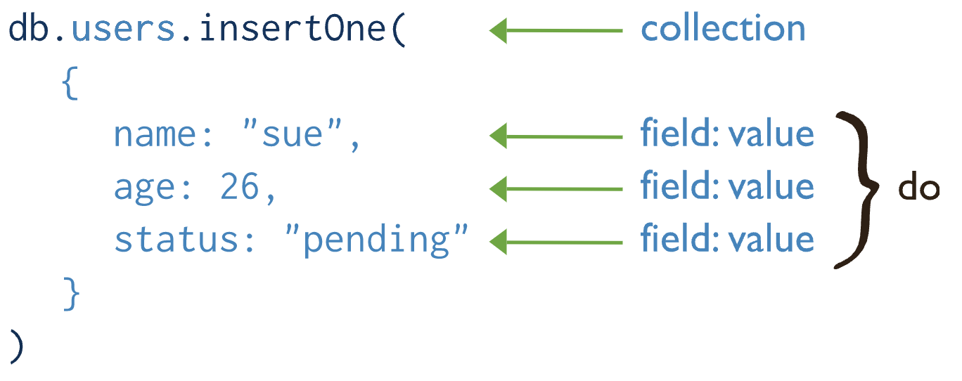
C: CREATE
Create or insert operations add new documents to a collection. If the collection does not currently exist, insert operations will create the collection.
MongoDB provides the following methods to insert documents into a collection:
db.collection.insertOne()
db.collection.insertMany()

Slide 62
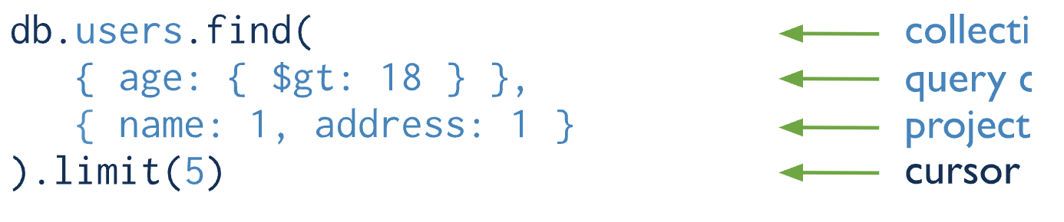
R: READ
Read operations retrieve documents from a collection; i.e. query a collection for documents. MongoDB provides the following methods to read documents from a collection:
db.collection.find()
You can specify query filters or criteria that identify the documents to return.

Slide 63
U: UPDATE
Update operations modify existing documents in a collection. MongoDB provides the following methods to update documents of a collection:
db.collection.updateOne()
db.collection.updateMany()
db.collection.replaceOne()
In MongoDB, update operations target a single collection. All write operations in MongoDB are atomic on the level of a single document.

Slide 64
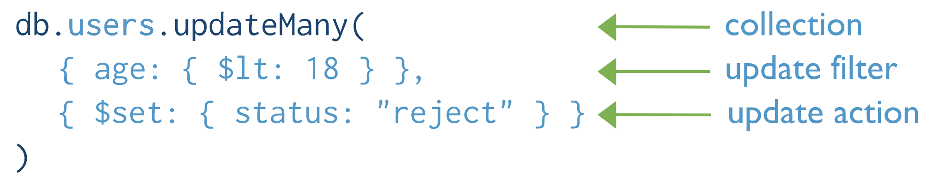
U: UPDATE
You can specify criteria, or filters, that identify the documents to update. These filters use the same syntax as read operations.

Slide 65
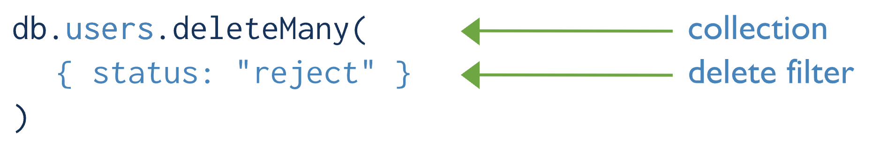
D: DELETE
Delete operations remove documents from a collection. MongoDB provides the following methods to delete documents of a collection:
You can specify criteria, or filters, that identify the documents to remove. These filters use the same as read operations.
db.collection.deleteOne()
db.collection.deleteMany()
In MongoDB, delete operations target a single collection. All write operations in MongoDB are atomic on the level of a single document.

Slide 66
Querying
The find() Method
To query data from MongoDB collection, you need to use MongoDB's find() method.
Syntax
The basic syntax of find() method is as follows −
>db.COLLECTION_NAME.find()
find() method will display all the documents in a non-structured way.

Slide 67
Conti…
The findOne() method
Apart from the find() method, there is findOne() method, that returns only one document.
Syntax
>db.COLLECTIONNAME.findOne()

Slide 68
Conti…
Operation | Syntax | Example | RDBMS Equivalent
Equality | {<key>:{$eg;<value>}} | db.mycol.find({"by":"tutorials point"}).pretty() | where by = 'tutorials point'
Less Than | {<key>:{$lt:<value>}} | db.mycol.find({"likes":{$lt:50}}).pretty() | where likes < 50
Less Than Equals | {<key>:{$lte:<value>}} | db.mycol.find({"likes":{$lte:50}}).pretty() | where likes <= 50
Greater Than | {<key>:{$gt:<value>}} | db.mycol.find({"likes":{$gt:50}}).pretty() | where likes > 50
Greater Than Equals | {<key>:{$gte:<value>}} | db.mycol.find({"likes":{$gte:50}}).pretty() | where likes >= 50
Not Equals | {<key>:{$ne:<value>}} | db.mycol.find({"likes":{$ne:50}}).pretty() | where likes != 50
Values in an array |  | db.mycol.find({"name":{$in:["Raj", "Ram", "Raghu"]}}).pretty() | Where name matches any of the value in :["Raj", "Ram", "Raghu"]
Values not in an array | {<key>:{$nin:<value>}} | db.mycol.find({"name":{$nin:["Ramu", "Raghav"]}}).pretty() | Where name values is not in the array :["Ramu", "Raghav"] or, doesn’t exist at all

Slide 69
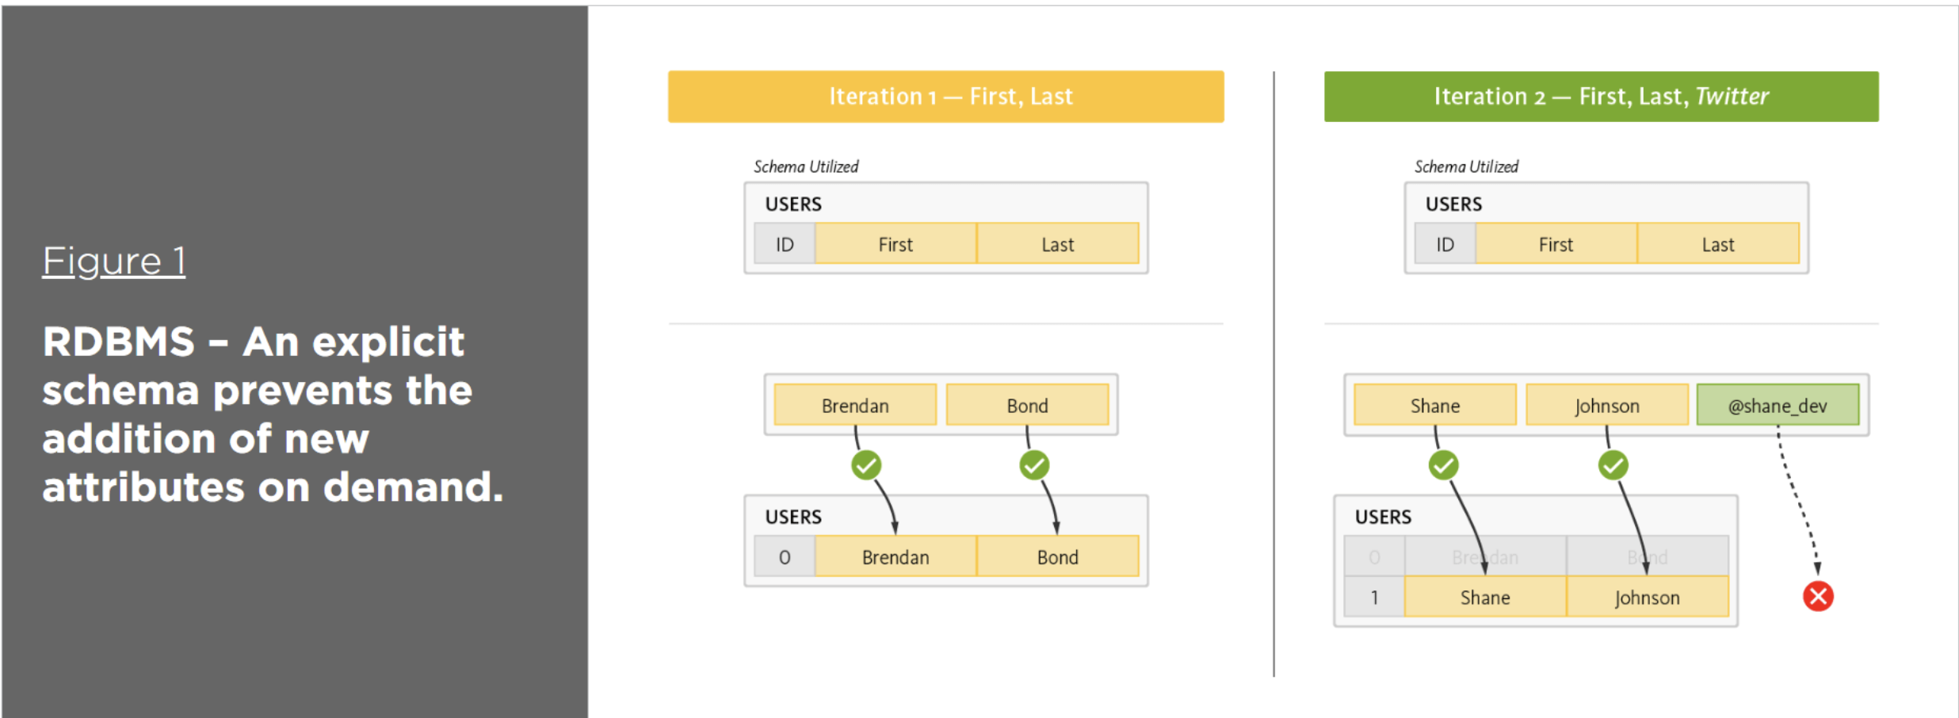
Modifying and Managing NoSQL Data stores

Slide 70
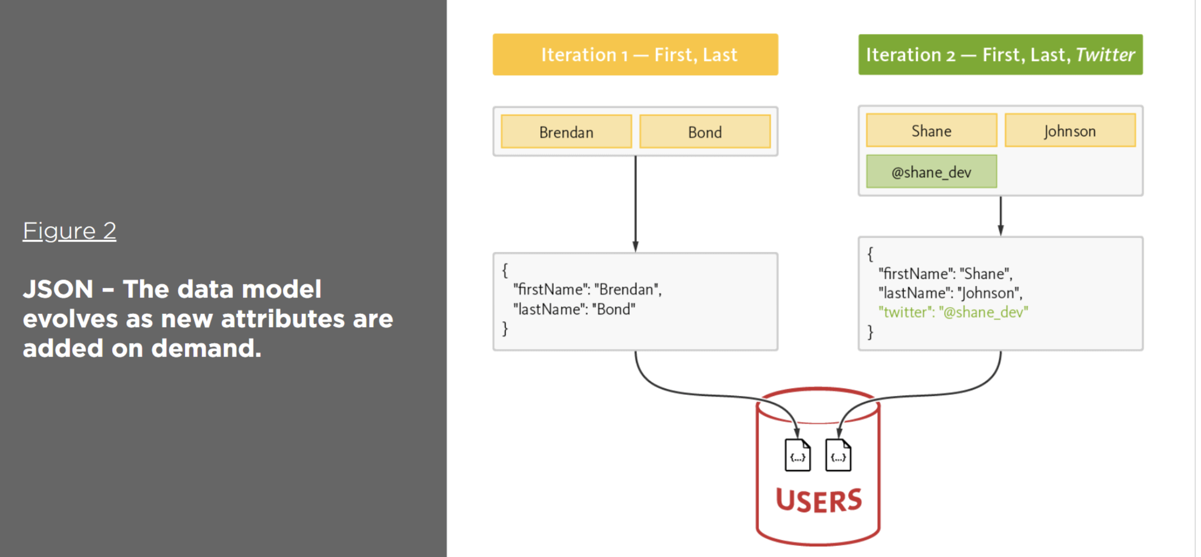
Modifying and Managing NoSQL Data stores

Slide 71
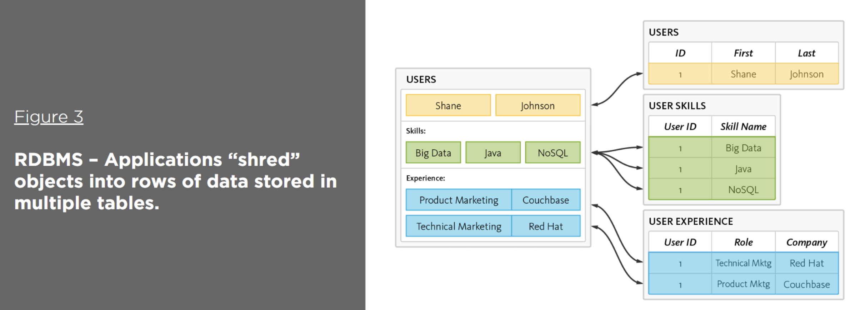
Modifying and Managing NoSQL Data stores

Slide 72
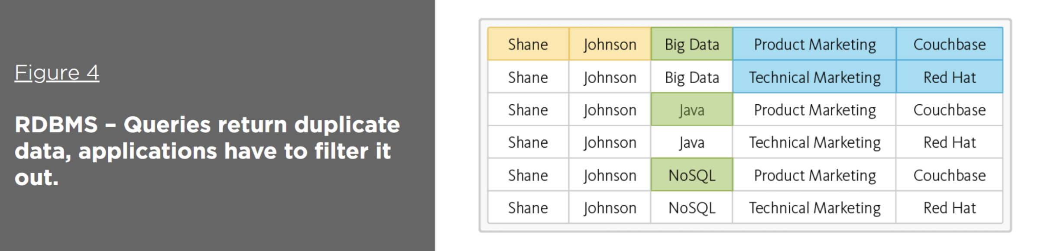
Modifying and Managing NoSQL Data stores

Slide 73
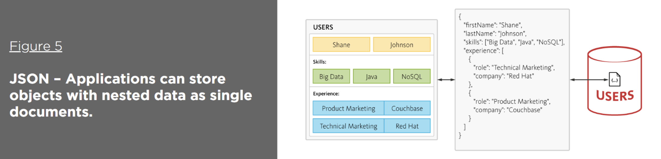
Modifying and Managing NoSQL Data stores
Link

Slide 74
Indexing in MongoDB
Indexing in MongoDB : MongoDB uses indexing in order to make the query processing more efficient. If there is no indexing, then the MongoDB must scan every document in the collection and retrieve only those documents that match the query. Indexes are special data structures that stores some information related to the documents such that it becomes easy for MongoDB to find the right data file. The indexes are order by the value of the field specified in the index.
1. Creating an Index : MongoDB provides a method called createIndex() that allows user to create an index.
Syntax –
db.COLLECTION_NAME.createIndex({KEY:1})

Slide 75
Conti...
2. Drop an index: In order to drop an index, MongoDB provides the dropIndex() method.
Syntax –
db.NAME_OF_COLLECTION.dropIndex({KEY:1})
3. Get description of all indexes : The getIndexes() method in MongoDB gives a description of all the indexes that exists in the given collection.
Syntax –
db.NAME_OF_COLLECTION.getIndexes()

Slide 76
Recap and Video
NoSQL Database introduction
MongoDB Introduction and CRUD operations
Modifying and Indexing Datasets
Video Link: https://www.youtube.com/watch?v=ofme2o29ngU&ab_channel=WebDevSimplified

Slide 77

Previous year question paper

Slide 78
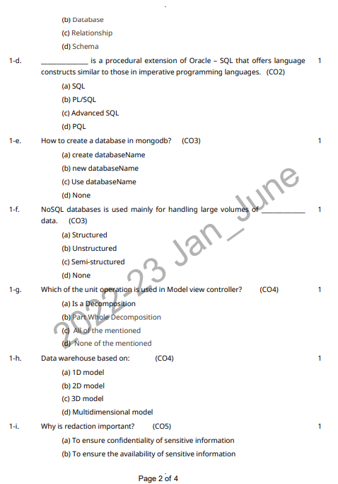
Previous year question paper

Slide 79

Previous year question paper

Slide 80

Previous year question paper

Slide 81
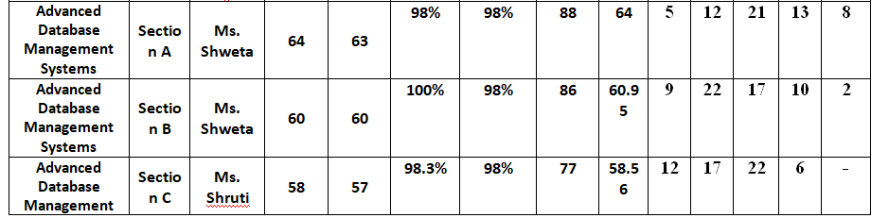
Result Analysis

Slide 82
MCQ
1. Which of the following is not a NoSQL database?
a) SQL Server
b) MongoDB
c) Cassandra
d) None of the mentioned
2. Point out the correct statement.
a) Documents can contain many different key-value pairs, or key-array pairs, or even nested documents
b) MongoDB has official drivers for a variety of popular programming languages and development environments
c) When compared to relational databases, NoSQL databases are more scalable and provide superior performance
d) All of the mentioned
3. Which of the following is a NoSQL Database Type?
a) SQL
b) Document databases
c) JSON
d) All of the mentioned
4. Which of the following is a wide-column store?
a) Cassandra
b) Riak
c) MongoDB
d) Redis

Slide 83
Thank You

